Slide 1

Credit Card Fraud Detection
Presented by :
Anshika Singh
DATA VISUALIZATION PROJECT

Slide 2
Introduction to Credit Card Fraud Detection
Credit card fraud has become a major issue in the digital economy, causing significant financial losses to individuals and organizations. With the rapid growth of online transactions, detecting fraudulent activities has become increasingly challenging.
This project focuses on analyzing transaction data to identify patterns and anomalies that indicate fraud. By using data analysis techniques, we aim to build insights that help in early detection and prevention of fraudulent transactions.

Slide 3
Problem Statement
Fraudulent transactions are rare but highly impactful
Difficult to detect due to large volume of transactions
Fraudsters continuously evolve their techniques
Need for accurate and fast detection system
Objective:
To analyze transaction data and identify key indicators (KPIs) that help in detecting fraud effectively.

Slide 4
Dataset Description
Source: Kaggle
Total Transactions: Approx 2 lakh +
Features:
Transaction Amount
Time
Transaction Type
Class (Fraud / Non-Fraud)
Note: Dataset is highly imbalanced (fraud cases are very few compared to normal transactions).

Slide 5
Data Preprocessing
Handling missing values
Data normalization / scaling
Removing duplicates
Feature selection
Outcome: Clean and structured dataset ready for analysis.

Slide 6
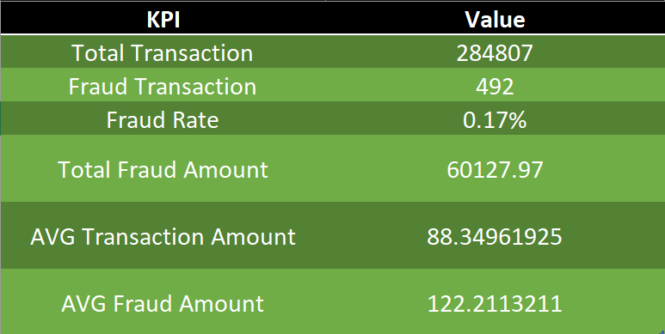
Key Performance Indicator (KPIs)

Slide 7
KPI Formulas
Fraud Rate = (Fraud Transactions / Total Transactions) × 100
Average Transaction Amount = Total Amount / Total Transactions
Fraud Loss = Sum of Fraudulent Transaction Amounts
These KPIs help in understanding fraud patterns and financial impact.

Slide 8
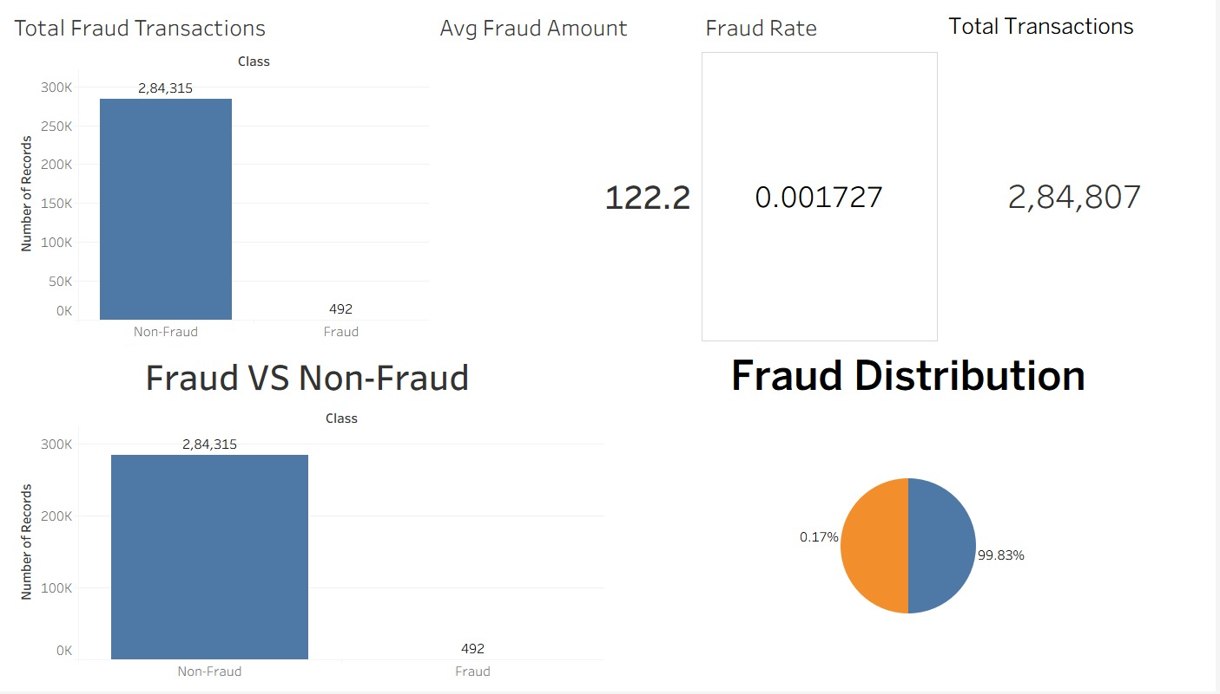
KPI Analysis

Slide 9
KPI Analysis
🔹 1. Total Transactions
Total Transactions: 284,807
Represents overall dataset size
Includes both fraud and non-fraud
transactions.
🔹 3. Fraud Rate (%)
Fraud Rate: ~0.17%
Indicates percentage of fraud transactions Shows high class imbalance
🔹 2. Total Fraud Transactions
Fraud Transactions: 492
Very small portion of total transactions Indicates rarity of fraud cases.
🔹 4. Average Fraud Amount
Average Fraud Amount: ₹ / value from Tableau Helps understand fraud transaction value Useful for financial risk estimation

Slide 10
KPI Analysis
🔹 5. Fraud vs Non-Fraud (Bar Chart)
Non-Fraud transactions dominate dataset Fraud transactions are very few Strong imbalance observed
🔹 6. Fraud Distribution (Pie Chart)
Fraud: ~0.17%
Non-Fraud: ~99.83%
Visual representation of imbalance
“From the KPI analysis, we conclude that the dataset is highly imbalanced, with very few fraud cases. However, these cases are critical due to their financial impact. Therefore, effective fraud detection requires advanced analytical techniques.”

Slide 11
Key Insights
Fraud transactions are significantly lower in number
High-value transactions have higher fraud probability
Certain time periods show increased fraud activity
Imbalanced dataset requires careful analysis

Slide 12
Conclusion & Future Scope
Conclusion:
Data analysis helps in identifying fraud patterns
KPIs provide measurable indicators for fraud detection
Visualization improves understanding of trends
Future Scope:
Implement Machine Learning models
Real-time fraud detection system
Improve accuracy using advanced algorithms

Slide 13
Thank You

